Slide 1


A research project on privacy of distributed algorithms
Project number:2901
Tom Kaninin, Jonathan Yaffe
Supervisor: Ilai Bistritz
Project carried out at: Tel Aviv University

Slide 2
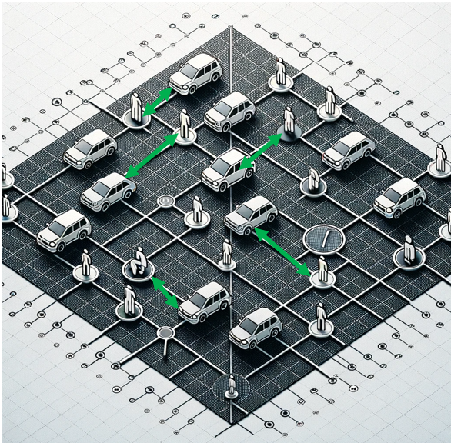
Private Ride Sharing
Notes:
About ride sharing - Ride-sharing is a service that allows individuals to book shared rides via mobile apps, transforming urban mobility by providing cost-effective and convenient transportation alternatives. This model not only reduces traffic congestion and emissions but also offers increased accessibility, particularly benefiting those who may not own a vehicle or are unable to drive.

Slide 3
Project Formulation and Goals
Ride-Sharing as a matching problem with the sum of pickup times as the performance measure
Location uncertainty guarantees privacy
Location uncertainty deteriorates performance

Slide 4
Project Requirements and Deliverables
Problem formulation
Theory: privacy measure
Algorithm design: distributed matching algorithm
Python simulator: evaluation of different algorithms

Slide 5
Updated and Elaborated Block Diagram
Each passenger adds uniform ball noise to its location and sends to server
The server runs a centralized algorithm and finds a matching
Centralized Approach
Collect Passenger locations
Calculate distance from each driver
Add uniform noise for each distance independently and send to each driver the corresponding distance
Each driver runs a distributed algorithm and finds a matching
Distributed Approach

Slide 6
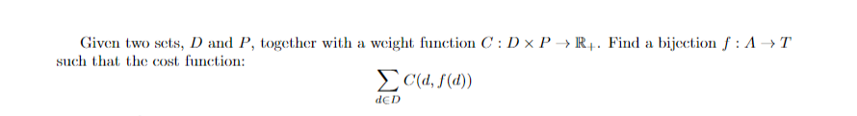
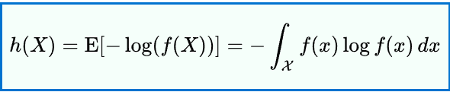
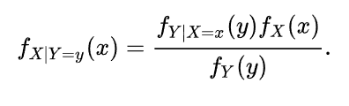
Deliverable I: Quantitative Measures
Performance: sum of pickup times
Privacy: differential Entropy
Location ball noise
Distance noise
Notes:
In the left case the center of the ball is the reported location. In the right case the center of the ring is the driver’s location. We assume that the distribution of the noised locations is the same as the distribution of locations so we can use bayes rule to find the PDF of the passenger location.

Slide 7
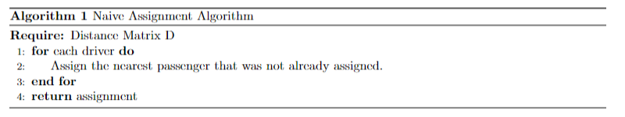
Deliverable II: Algorithms
Centralized and distributed algorithms - Naïve algorithm, Hungarian algorithm

Slide 8
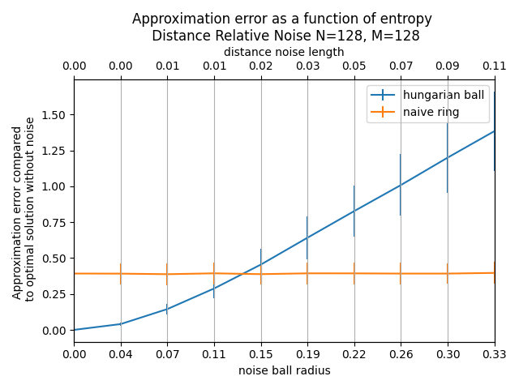
Deliverable III: Preliminary simulations

Slide 9
Milestone | Planned delivery date | Actual delivery date | Remarks
Mathematical problem formulation | 25.3.2024 | 25.3.2024 | -
Basic simulation software implementation | 25.3.2024 | 25.3.2024 | -
Literature review completion | 25.3.2024 | 25.3.2024 | -
Algorithm development | 25.4.2024 | 10.4.2024 | -
Evaluation of centralized algorithm vs distributive algorithm | 25.4.2024 | 10.4.2024 | -
Real world data collection | 27.6.2024 | 13.6.2024 | -
Time domain expansion | 27.6.2024 | 13.6.2024 | -
Privacy assessment report | 5.7.2024 | 5.7.2024 | -
Full simulation software release | 5.7.2024 | 5.7.2024 | -
Poster Submission and finishing the work | 14.7.2024 | 14.7.2024 | -
Future work roadmap | 12.8.2024 | 12.8.2024 | -
Final deliverables submission | 12.8.2024 | 12.8.2024 | -

